Slide 1

Vel Tech Rangarajan Dr. Sagunthala R&D Institute of Science and Technology
School of Computing
Department of Computer Science and Engineering
10211CS224 / FULL STACK APPLICATION DEVELOPMENT (JAVA)
PROJECT REVIEW : MILESTONE PROJECT – 1
Date: 02-02-2026
Automated Quiz Engine with PDF Certification Generation
SDG: SDG 4 – Quality Education
Presented By:
J.POORNA CHANDAR – VTU25980 – 23UECS0748.
Courses Handling Faculty:
Dr. S . HEMAMALINI – M.E., Ph.D.,

Slide 2
INTRODUCTION
Background of the problem:
It addresses the limitations of traditional exams by providing a flexible, automated platform for conducting tests online and instantly analyzing results. This reduces manual effort, ensures accuracy, and delivers quick feedback to students and administrators
Why this project is important:
It streamlines learning assessments and validates knowledge instantly.
Real-world relevance:
Useful for online courses, corporate training, and skill evaluations.
Brief overview of the system:
An automated quiz engine that generates results and grades.
1
2
3
4
5
6
7
8
9

Slide 3
PROBLEM STATEMENT
Traditional examination systems are often slow, resource‑heavy, and vulnerable to human error, leading to inefficiencies in both conducting exams and processing results. Manual evaluation delays the release of outcomes, which in turn affects timely academic decisions and student progress. Learners are deprived of instant feedback and detailed performance insights that could guide their improvement. At the same time, institutions face challenges in securely managing large volumes of exam data while ensuring scalability and user‑friendliness. Existing solutions frequently lack dynamic adaptability and comprehensive analysis features. Therefore, there is a pressing need for a robust online platform that automates exam conduction, evaluation, and result analysis in an efficient, secure, and scalable manner
1
2
3
4
5
6
7
8
9

Slide 4
OBJECTIVES
1
2
Automate Examination Process – To design and implement a secure, scalable platform that enables dynamic creation, scheduling, and conduction of online exams with minimal manual intervention.
Instant Evaluation & Feedback – To integrate automated result processing that provides students with immediate scores, detailed performance analysis, and personalized feedback for improvement.
3.Efficient Data Management & Reporting – To ensure secure storage, retrieval, and analysis of examination data, enabling institutions to generate insightful reports and make timely academic decisions.
3
4
5
6
7
8
9

Slide 5
PROPOSED SYSTEM
1.The proposed system is a Dynamic online quiz and result analysis that manages users, quizzes, evaluation, in one platform
2. It allows users to register and attend exams easily.
3. Admin can create and manage tests.
4. The system checks answers and calculates marks automatically.
5. It generates scores and grades for students who pass the quiz.
6. It reduces manual work and saves time.
7. It avoids mistakes in result calculation.
8. It is faster and more efficient than manual systems.
1
2
3
4
5
6
7
8
9

Slide 6
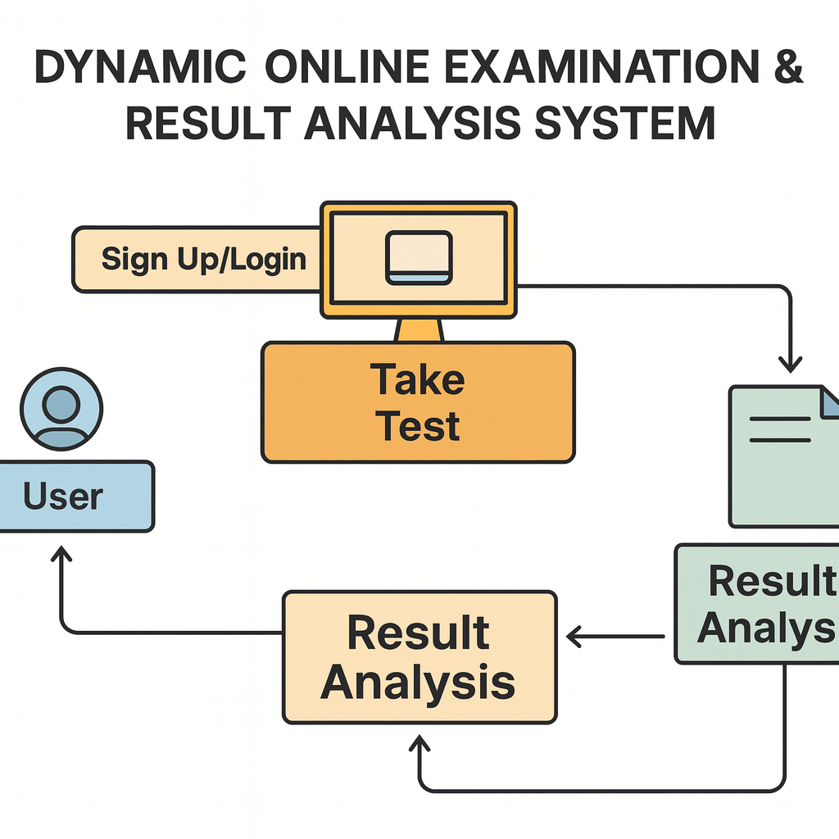
PROPOSED SYSTEM ARCHITECTURE
1
2
3
4
5
6
7
8
9

Slide 7
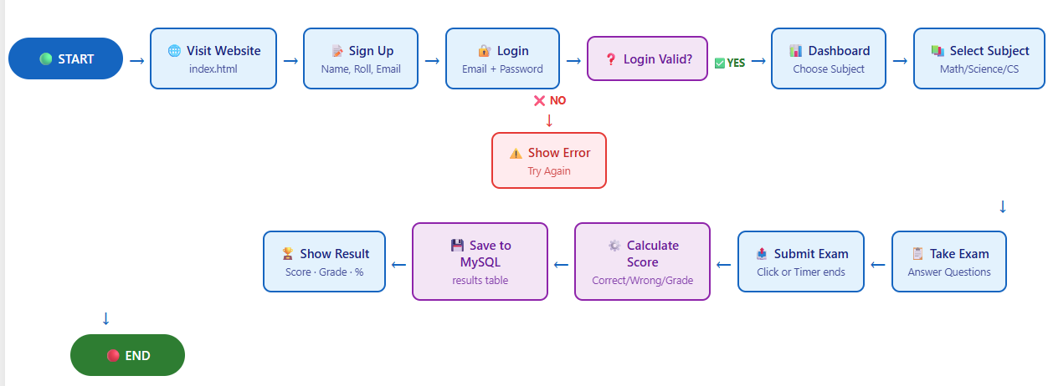
WORKFLOW
1
2
3
4
5
6
7
8
9

Slide 8
TECHNOLOGIES USED
Frontend:
1.HTML5
2.CSS5
3.Javascript
Backend:
1.Java Spring Boot
2.Spring security
Tools:
1.Eclipse IDE
Software Requirements:
1.Windows / Mac
2. Web Browser
Database:
1.Mysql
1
2
3
4
5
6
7
8
9

Slide 9
MODULE DESCRIPTION
Module 1: User Management
Handles user registration, login, and profile management with secure authentication.
Module 2: Test Management
Allows Admin to create , update , delete , quizzes and manage questions.
Module 3: Test Execution & Evaluation
Conducts Tests , record answers, and automatically calculates scores.
Module 4: Result and grade generation
Generates results and grades for users who pass the quiz.
1
2
3
4
5
6
7
8
9

Slide 10
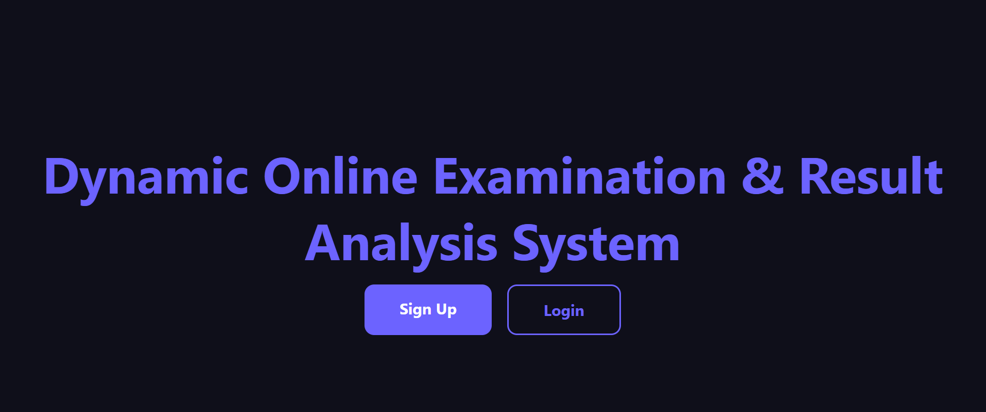
IMPLEMENTATION SCREENSHOTS
SIGN UP & LOGIN PAGE:
1
2
3
4
5
6
7
8
9

Slide 11
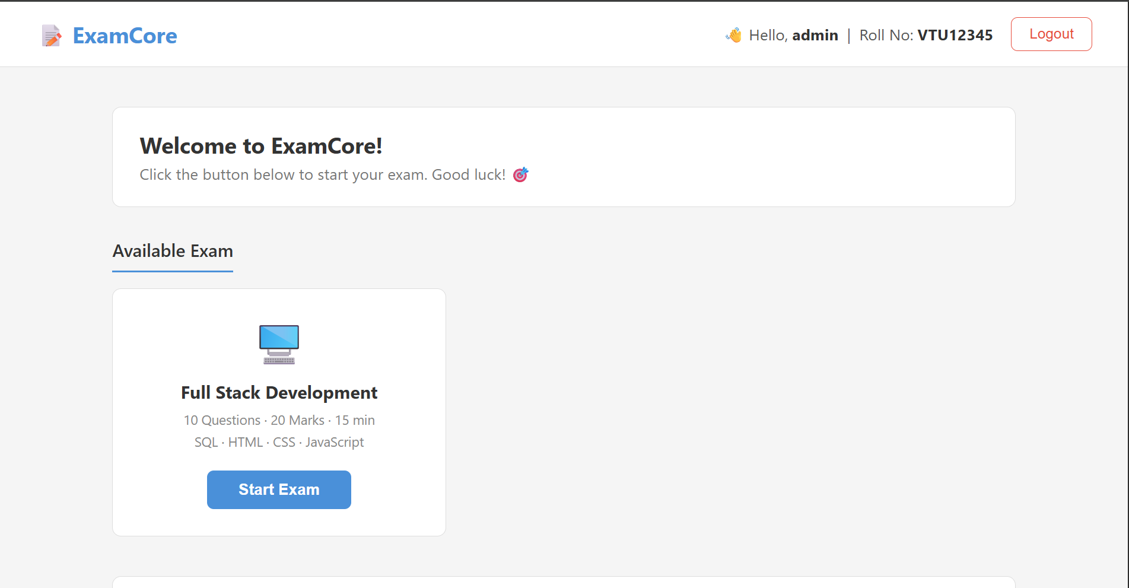
IMPLEMENTATION SCREENSHOTS
Main Page :
1
2
3
4
5
6
7
8(A)
9

Slide 12
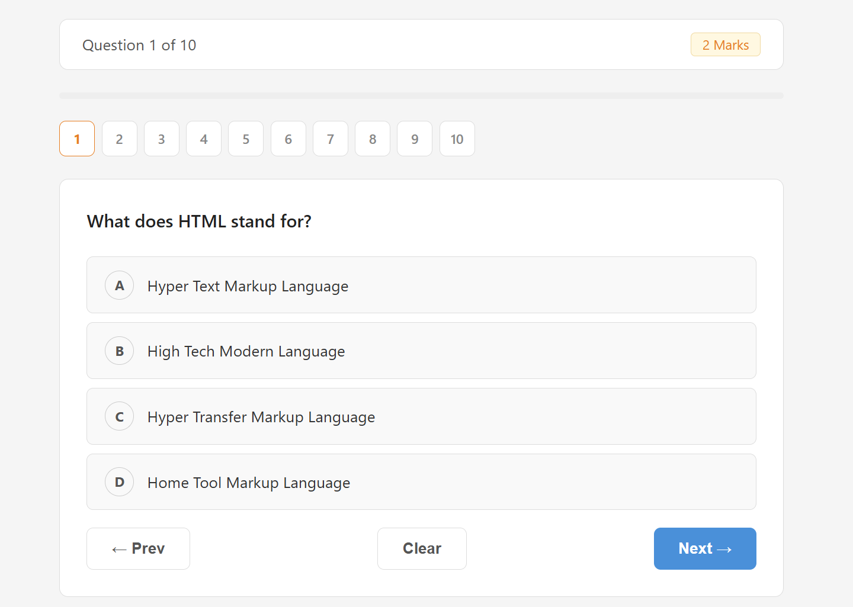
IMPLEMENTATION SCREENSHOTS
1
2
3
4
5
6
7
8(B)
9

Slide 13
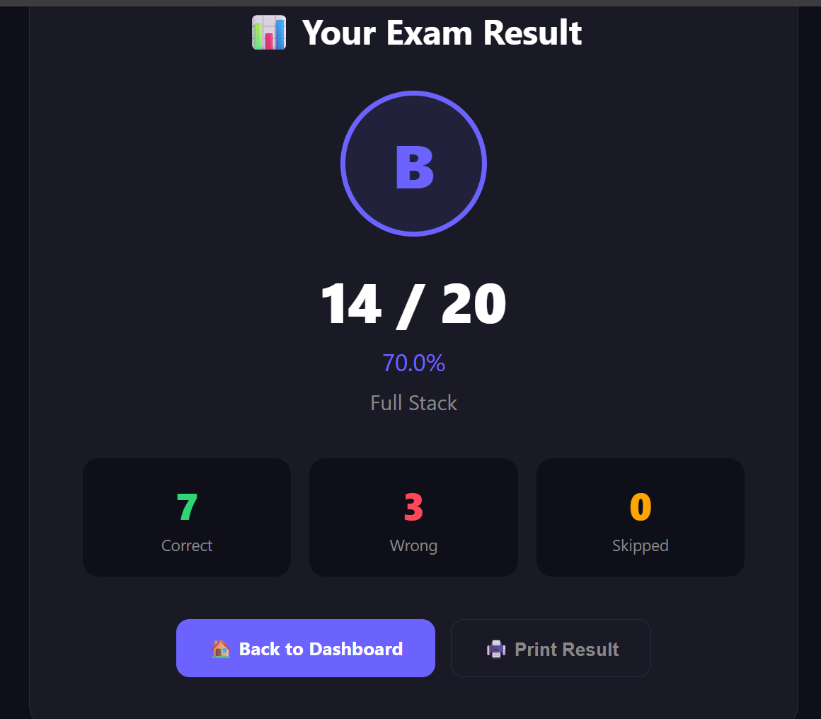
IMPLEMENTATION SCREENSHOTS
1
2
3
4
5
6
7
8(C)
9

Slide 14
ADVANTAGES & LIMITATIONS
Advantages:
1.Time saving and Fully Automated.
2.Instant result .
3.Easy Access & Scalable.
Limitations:
1.Limited to Objective-Type Questions.
2.Internet Dependency(Stable Internet connection is Required).
3.Security and Malpractice Issues.
1
2
3
4
5
6
7
8
9

Slide 15
Thank you

